Slide 1
Process and translate speech with Azure Cognitive Speech Services
組員:施育暘、周志鴻、邱正皓

Slide 2
Topic : Translate speech in real time with Azure Cognitive Services
Table of Contents :
Introduction
Overview of speech translation
Exercise - Create a subscription to the Speech Translation API
Exercise - View subscription keys and endpoints
Use the API to translate speech
Use the API to request supported speech languages
Listen for incoming translation data
Knowledge check
Summary
In this module you will learn how to translate speech and convert it to text through real-time transcription with the Speech Translation API in Azure Cognitive Services

Slide 3
Introduction :
What is Speech Translation API :
The Speech Translation API transcribes audio streams into text. Your application can display this text to the user or act upon it as command input. You can use this API either with an SDK client library (for supported platforms and languages) or a representational state transfer (REST) API.
With the Speech Translation API, you can :
Extend the reach of your applications across mobile, desktop, and web.
Easily translate to and from 10 languages through the open REST interface of the Speech Translation API. This API is a cloud-based automatic speech-translation service (also known as machine translation).

Slide 4
Overview of speech translation :
The Speech services in Azure Cognitive Services provide real-time translation of spoken content based on machine learning and artificial intelligence. The Speech services APIs allow developers to add end-to-end, real-time speech translations to their applications or services.
Apply for real-time speech translation :
1. Translation of live presentations
2. In-person or remote translated communications
3. Customer support
4. Business intelligence
5. Media subtitling
6. Multilingual AI interactions

Slide 5
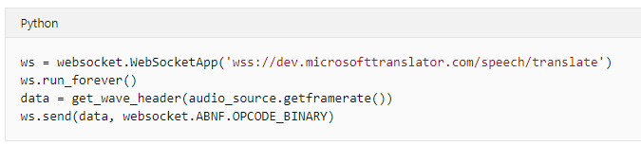
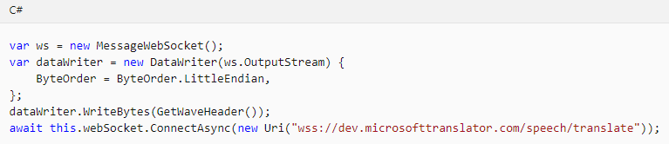
Calling the Speech Translation API

Slide 6
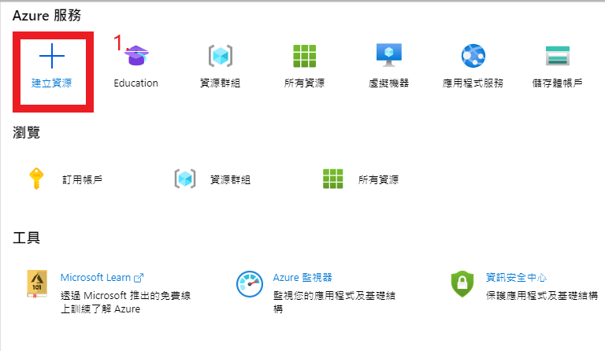
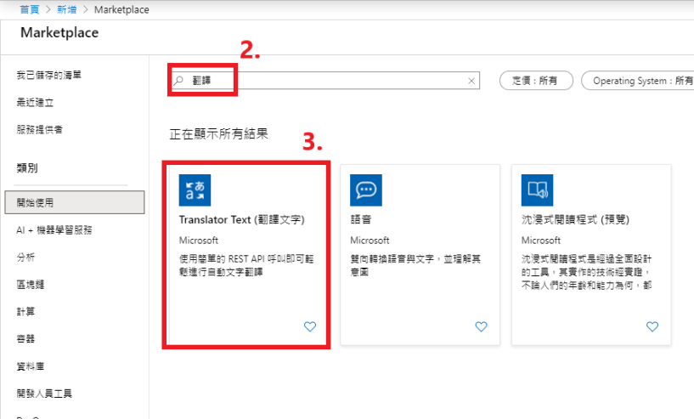
Create a subscription to the Speech Translation API :
Sign in to the Azure portal .
Select ”Create a resource” , in “Marketplace”, type “translation”
Select Translator Text. And create it.

Slide 7
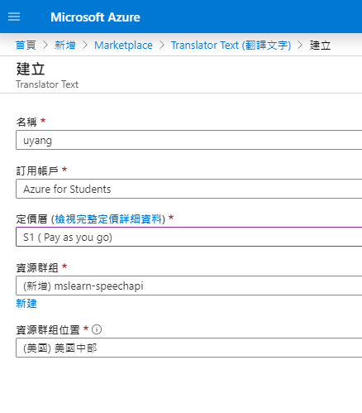
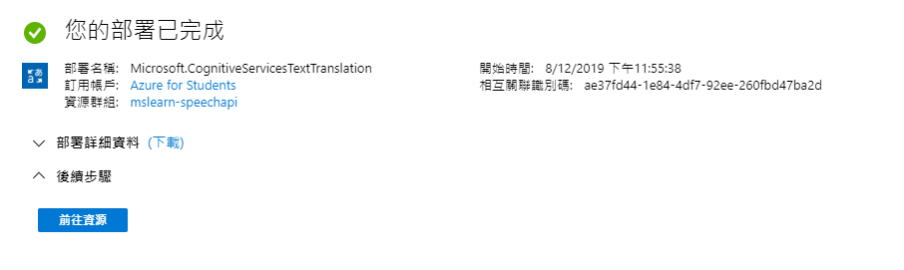
4. Enter a name for your Speech Translation API subscription,
5. For Pricing tier, select a tier.
6. Create a new resource group named ”mslearn-speechapi” to hold your resources. And Select ”Create” to create your subscription
7. Go to resources.
4
5
6
7.

Slide 8
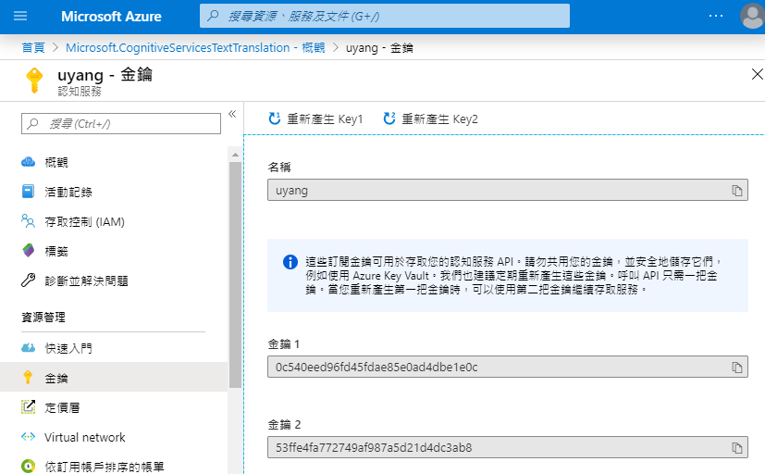
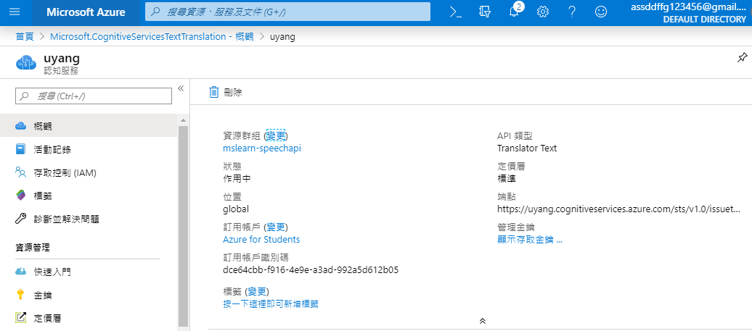
View subscription keys and endpoints
View the subscription keys :
Select Keys to view your new API keys.
View the endpoint :
Find Endpoint, and make note of the endpoint value. This URL will be used when temporary tokens are generated.

Slide 9
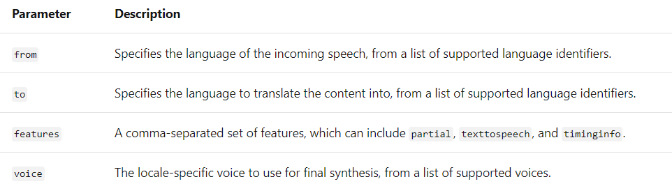
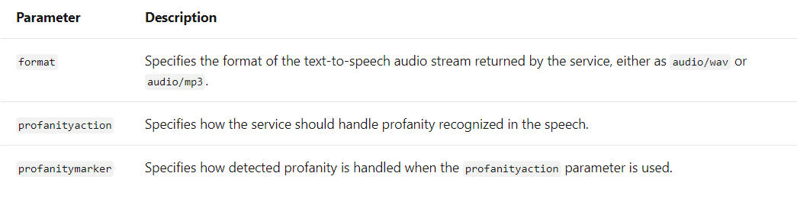
Use the API to translate speech
two steps :
Creating and opening an authorized WebSocket request to the subscription endpoint.
Processing the information returned from the call.
The translate methodprovides the following required parameters:

Slide 10
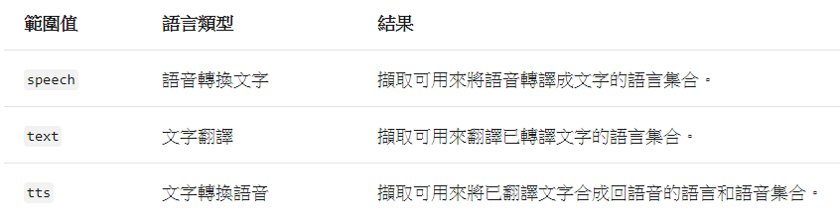
Use the API to request supported speech languages
Speech-translation services are designed to target specific language-translation scenarios. The supported speech languages are delineated by the following types:
speech to text, text translation, and text to speech

Slide 11
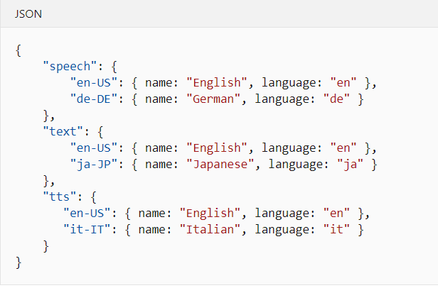
Return values :
Textual information is returned from the Speech Translation API in a well-formatted JSON object or array.
The previous example of requesting supported languages for speech to text, text translation, and text to speech (all scopes) will return the following result:

Slide 12

Listen for incoming translation data
Working with the Speech Translation API Recognize method starts with creating and opening an authorized WebSocket connection to the Speech Translation API endpoint.
Because a real-time, conversational translation process is ongoing, the Speech service uses the concept of "listening" to a socket for incoming translation data.

Slide 13
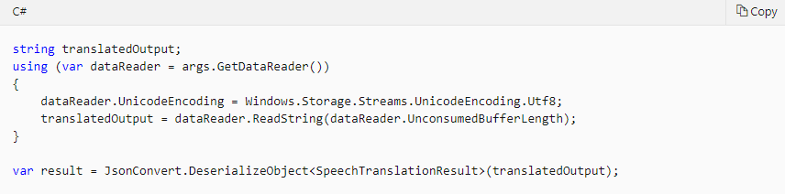
Reading streams
Listening for incoming translation data means evaluating streams or byte arrays returned by the Speech service in a constant, consistent fashion, as if you were engaging in a real human conversation.
For example, in C#, listening for an initial incoming translation might look like this:
In the prior example, a DataReader object is used to continually interrogate the returned values based on stream or byte-array buffer length. The Speech Translation API Translate method does all the converting, cleans up the data, translates speech to text, and responds with the final (or interim) translated content.

Slide 14
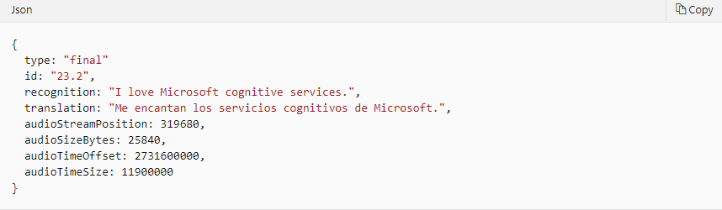
Initial return values
Because speech translation is a multistep process, initial data from a listening event comes in as a well-formatted JSON payload, just like it does for most other methods in the Azure Cognitive Services suite of APIs:
But after the text is translated, listening for translated text to be synthesized looks like any scenario where you're working with a stream or byte array instead of human-readable text

Slide 15
Summary
The Speech Translation API lets you add end-to-end, real-time, multilanguage translation of speech to your applications, tools, and devices.
The same API can be used for both speech-to-speech and speech-to-text translation.
With the Speech Translation API, client applications stream speech audio to the Speech service and receive back a stream of results. These results include the recognized text in the source language and its translation in the target language. Interim translations can be provided until an utterance is complete, at which time a final translation is provided.
For true speech-to-speech translation, a synthesized audio version of the final translation can also be prepared. The Speech Translation API uses the WebSocket protocol to provide a full-duplex communication channel between the client and the server. But you don't need to deal with WebSocket connections because the Speech SDK handles that for you.

Slide 16
Clean up
To avoid any unexpected costs in your Azure account, delete the mslearn-speechapi resource group. Deleting this group will remove all the resources we created in this module. Here are the steps you need to take:
In the left menu in the Azure portal, select Resource groups, and then find the mslearn-speechapi resource group.
Select the resource group, and either right-click the row or use the ellipsis (...) button at the end of the row to open the context menu.
Select Delete resource group.
Enter the name of the mslearn-speechapi resource group, and then select Delete. Azure will remove all the resources for you.

Slide 17
Topic2 : Recognize specific voices with the Speaker Recognition APIs in Azure Cognitive Services
Table of Contents :
Introduction
Overview of speaker recognition
Exercise - Create a Speaker Recognition API subscription
Overview of speaker verification concepts
Manage speaker verification profiles
Overview of speaker identification
Manage speaker identification profiles
Implement speaker recognition
Knowledge check - speaker recognition
Summary
In this module you will Learn how to use the Speaker Recognition APIs to identify specific people through their voices.

Slide 18
Introduction :
The Speaker Recognition APIs in Azure Cognitive Services provide advanced algorithms for speaker verification and speaker identification. These APIs allow you to build voice authorization into applications and identify specific voices.
In this module, you'll:
Learn what speaker recognition is all about.
Learn about concepts related to speaker recognition.
Explore the Speaker Recognition APIs.

Slide 19
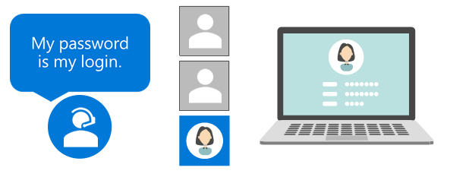
Overview of speaker recognition
The Speaker Recognition APIs in Azure Cognitive Services use machine learning and artificial intelligence to provide robust services that:
Identify individual speakers.
Use speech for authentication.
You can use any programming language or operating system to integrate these services into your apps and services.
Speaker recognition is divided into two categories:
Speaker verification: Automatically verify and authenticate users by using their voice or speech.
Speaker identification: Automatically identify the person who's speaking in an audio file by comparing the voice to a group of prospective speakers.

Slide 20
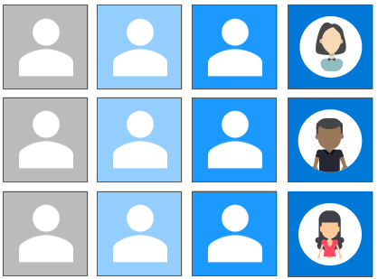
The Speaker Recognition APIs
All life forms seem to have built-in, biologically adapted methods of communication. Whether you're a blue whale, a bumblebee, a cicada, or a human, your individual "voice" is unique. Our planet is filled with over 7.5 billion human voices, each one unique and distinct from the others.
Through simple REST-based service calls, the Speaker Recognition APIs provide algorithms that allow you to:
Verify and identify human voices.
Organize voices into manageable profiles.

Slide 21
The methods provided by the Speaker Recognition APIs fall into three categories:
Verification: Checking the likelihood that two voices belong to the same person.
Identification and recognition: Determining whether a voice matches another known voice.
Enrollment: Registering voices to be verified or identified.
The Speaker Recognition APIs allow you to use the power of artificial intelligence to:
Authenticate users before allowing them to access apps and services.
Identify speakers in video streams.
Identify speakers in real-time chat scenarios.
Improve security for sensitive resources.
Replace cumbersome legacy authentication.
Speaker recognition is often referred to as "voice recognition." Speaker recognition is the process of identifying a person based on characteristics of that person's voice.

Slide 22

Great acoustics
Speaker recognition evaluates the vital acoustic features of speech that differ between individuals. These acoustic patterns are determined by things like the size and shape of someone's throat and mouth. Everyone also has certain speech patterns, such as speaking style and voice pitch.
Scientific progress in the field of speaker verification has resulted in speaker recognition now being classified as a "behavioral biometric." Just like the difference between speech recognition and speaker recognition, the acts of speaker verification and speaker identification also differ:
Speaker verification: An attempt to determine if a speaker has a certain "claimed" identity.
Speaker identification: An attempt to determine an unknown speaker's identity.
In both cases, existing voices or voice samples must be available for comparison. The process of creating voice samples is referred to as enrollment.

Slide 23
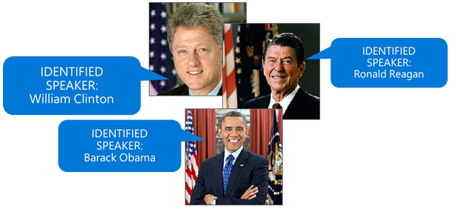
Enrollment
In speaker recognition, enrollment is the process of prerecording a speaker's voice to extract the acoustic and speech patterns that form a voice print. A voice print is often referred to as a voice template or voice model. In typical speaker-verification scenarios, sample speech "utterances" are prerecorded to use later when comparing voice prints.
The process of speaker identification is more difficult because many times an utterance is newly introduced to the system. For example, a speaker-recognition system could be trained to identify a famous US president from samples of inauguration speeches. But identifying a president from new content, such as a State of the Union speech, requires comparison of the spoken content against multiple voice prints to determine the best match.

Slide 24
Because the algorithms behind verification and identification are different, the enrollment processes for these services are also separate. Behind the scenes, two types of speaker-recognition systems are in effect: text-dependent and text-independent.
Text-dependent: Used for enrollment for speaker verification, where prompts are known and common across all speakers.
Text-independent: Used for enrollment for speaker identification, where there's no (needed) cooperation by the speaker.
Note :
For text-independent scenarios, enrollment often happens without a user's knowledge, because speaker-identification systems don't need to compare what was said at enrollment.
The text-dependent system, which is the most controlled of these systems, is at the core of speaker verification.

Slide 25
Exercise - Create a Speaker Recognition API subscription
Before you can use the Speaker Recognition APIs, you need to subscribe to the service and get a subscription key.
Important
The Speaker Recognition APIs are still in preview. Expect changes to some of the functionality before it's finalized.
Sign in to the Azure portal .
In the left pane, select + Create a resource.
In the Search the Marketplace box, enter speaker recognition, and then press Enter.
In the search results, select Speaker Recognition.
Select Create.
Enter a name for your subscription to the Speaker Recognition APIs, such as SpeakerRecognition.
For Location, choose the one nearest you.
For Pricing tier, select a tier.
Create a new resource group named mslearn-speakerapi to hold the resources.
Review and accept the service notice, then select Create to create a subscription to the Speaker Recognition APIs.

Slide 26
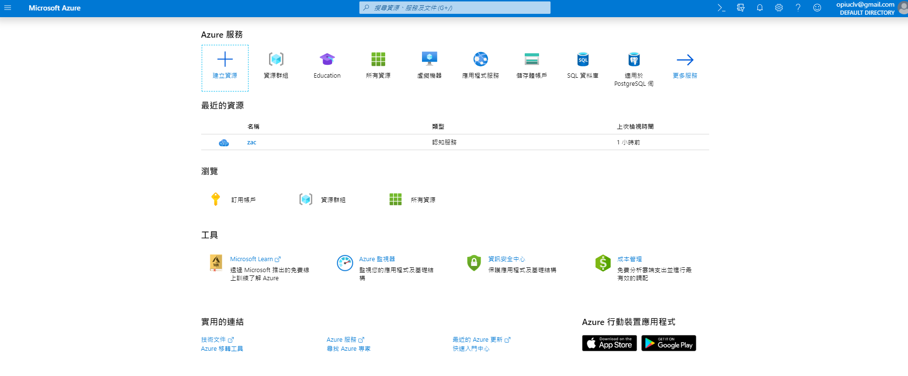
Sign in to the Azure portal .
In the left pane, select + Create a resource.

Slide 27
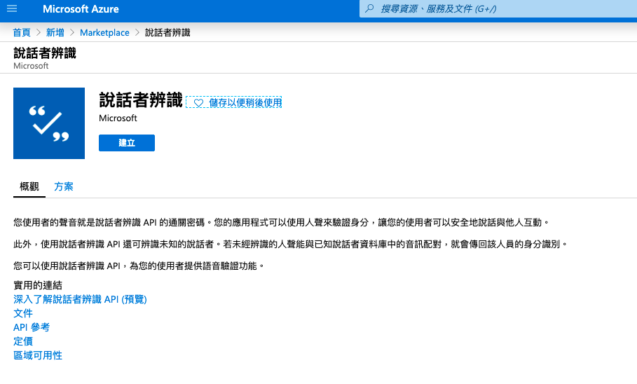
3. In the Search the Marketplace box, enter speaker recognition, and then press Enter.
4. In the search results, select Speaker Recognition.
5. Select Create.

Slide 28
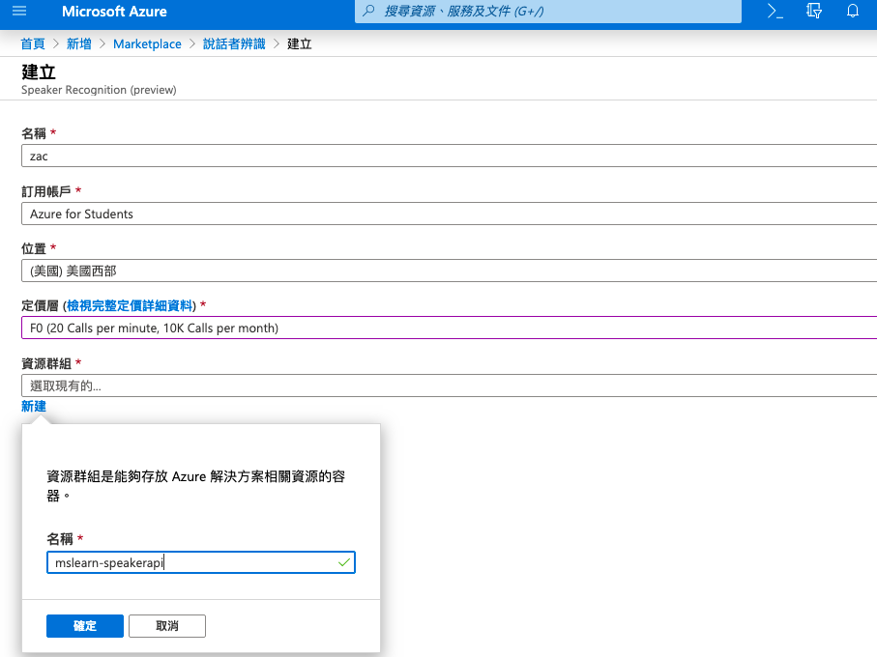
6. Enter a name for your subscription to the Speaker Recognition APIs, such as SpeakerRecognition.
7. For Location, choose the one nearest you.
8. For Pricing tier, select a tier.
Create a new resource group named mslearn-speakerapi to hold the resources.
10. Review and accept the service notice, then select Create to create a subscription to the Speaker Recognition APIs.

Slide 29
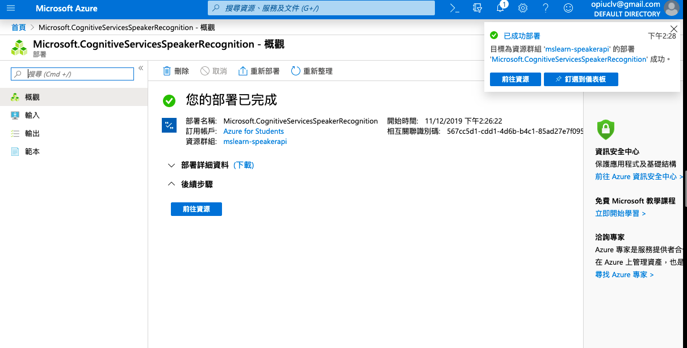
Next…Complete deployment

Slide 30
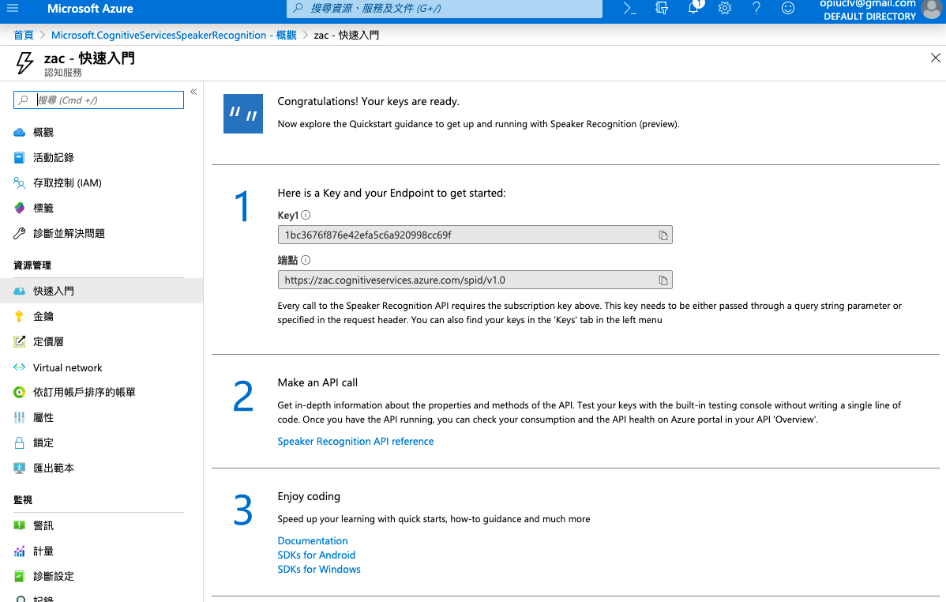
Congratulations

Slide 31
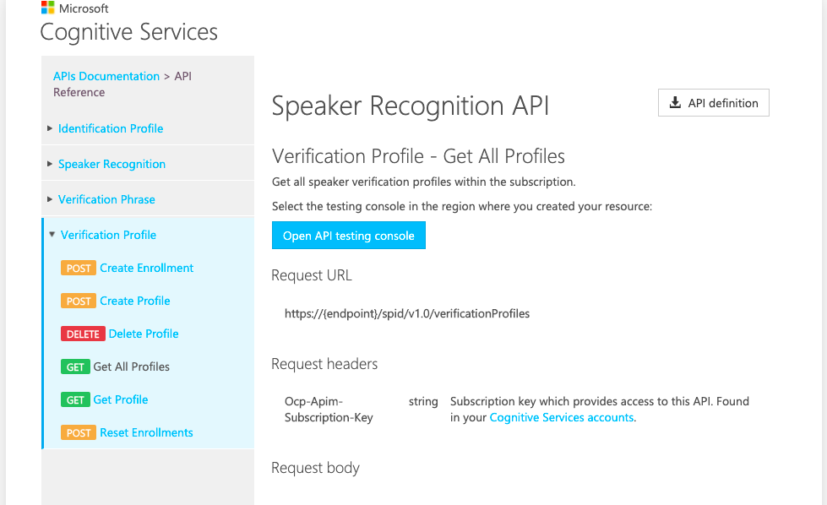
Speaker Recognition API

Slide 32

Overview of speaker verification concepts
If you're a veteran of traveling abroad, you're used to presenting government-issued documents when visiting a new country. Speaker verification is very much like the process of entering a new country with a passport.
When you present your passport to the immigration officer, you're claiming that the person in the passport's photo is you. Just like there are regulations for how this photo must be taken, the speaker-verification process usually has guidelines for what your voice print "looks" like. In other words, what you say to generate your voice print is regulated. Most systems use the concept of verification phrases.

Slide 33
Verification phrases
The Speaker Recognition service uses predefined verification phrases to determine the speaker's relevant speech and acoustic patterns and features. The Speaker Recognition service currently supports the following 10 verification phrases for the locale of English (United States):
"I am going to make them an offer they cannot refuse."
"Houston, we have a problem."
"My voice is my passport. Verify me."
"Apple juice tastes funny after toothpaste."
"You can get in without your password."
"You can activate the security system now."
"My voice is stronger than passwords."
"My password is not your business."
"My name is unknown to you."
"Be yourself. Everyone else is already taken.“
Note
The Speaker Recognition API doesn't currently support custom verification phrases.

Slide 34
Verification phrases
Speaker-verification enrollment requires you to record and submit three samples of an identical phrase. For example, you'd be required to repeat the phrase, "Houston, we have a problem," three separate times and then submit those samples to the system.
After you submit the identically phrased samples, your enrollment is considered complete. You can now be verified by using the identical verification phrase.
You might be wondering why an identical verification phrase is required. Why can't the system analyze and evaluate the speech and acoustic patterns of the speaker to determine a voice match? Actually, the system can identify a voice match without the use of an identical verification phrase.
But if any voice sample was allowed, the system would no longer be secure. Someone could record your voice and use that recording to get into the system. Requiring you to remember and use an exactly phrased sample is very much like requiring you to remember a password, your mother's maiden name, the name of your first pet, or the city in which you were born--only better.
When enrollment is complete, the Speaker Recognition system now contains your verification profile.

Slide 35
Verification profiles
A verification profile is a grouping of text-dependent enrollments used for speaker verification. Because a speaker must choose a specific phrase for both enrollment and verification, the resulting profile contains everything necessary for future speaker verification.
Tip
Although not absolutely necessary, we recommend using the same microphone for both enrollment and verification.

Slide 36
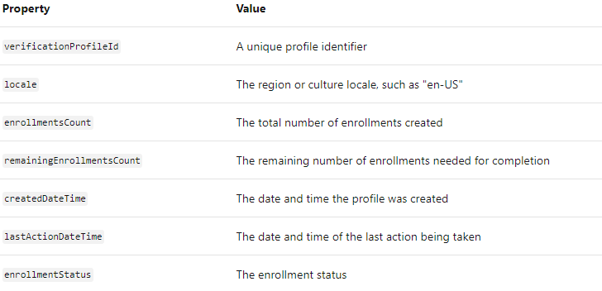
Verification profiles
The properties of a verification profile
In the Speaker Recognition APIs, a verification profile includes the following properties:

Slide 37
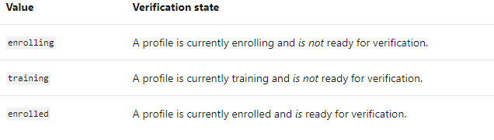
Verification profiles
Enrollment status property
Other than verificationProfileId, the most important property of a verification profile is enrollmentStatus. This value shows the current enrollment state and the readiness for speaker verification:

Slide 38
Manage speaker verification profiles
Use the Speaker Verification API to manage verification profiles
Managing speaker-verification profiles with the Speaker Verification API is a process of:
Sending an authorized web request to the subscription endpoint.
Observing the information returned from the call.

Slide 39
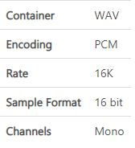
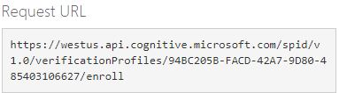
audio file:
The Create Enrollment method accepts an audio file (as a binary file payload) that must meet the following criteria
the endpoint URL:
A parameter passed to the Create Enrollment method is typically sent in the query string, as part of the endpoint URL

Slide 40
Send an audio payload
To send an audio payload to the Create Enrollment method, you must include a binary file, such as a stream or byte array, in the web request. You must then send the request via a standard HTTP POST method.

Slide 41
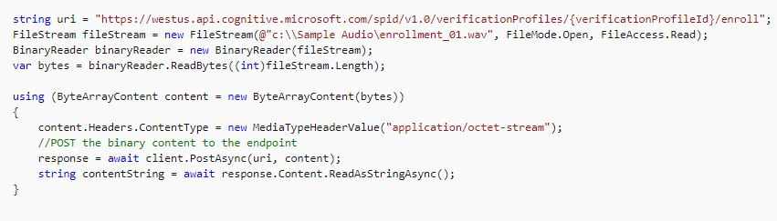
Binary file payload

Slide 42
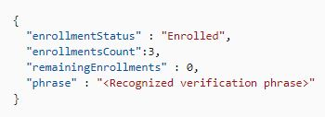
Return values
The results returned from the Speaker Verification API are contained in JSON payloads. Here's an example of the information returned from the Create Enrollment method:

Slide 43
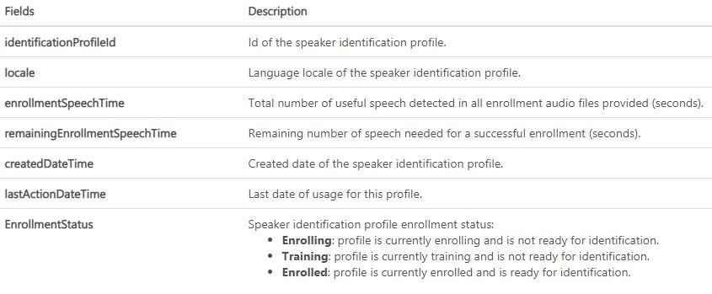
Identification profiles

Slide 44
Manage speaker identification profiles
Use the Speaker Identification API to manage identification profiles
Like speaker-verification profiles, you manage speaker-identification profiles with the Speaker Identification API by:
Sending an authorized web request to the subscription endpoint.
Observing the information returned from the call.

Slide 45
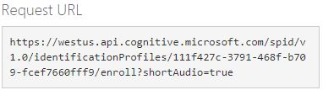
audio file:
The Create Enrollment method accepts an audio file (as a binary file payload) that must meet the same criteria as the files used for speaker verification
the endpoint URL:
A parameter passed to the Speaker Identification API Create Enrollment method is typically sent in the query string as part of the endpoint URL. This example includes the optional shortAudio parameter

Slide 46
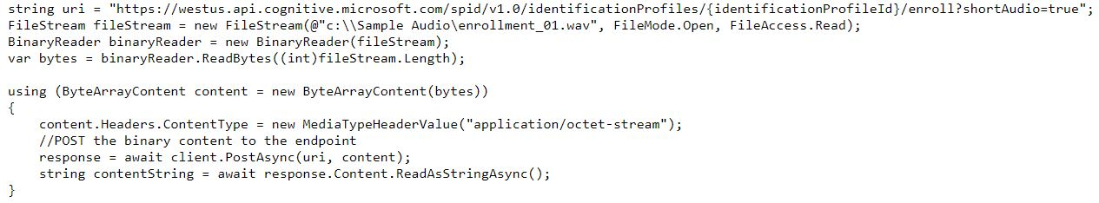
Send an audio payload
To send an audio payload to the Speaker Identification Create Enrollment method, you must include a binary file, such as a stream or byte array, in the web request, and then send the request via a standard HTTP POST method.
Binary file payload

Slide 47
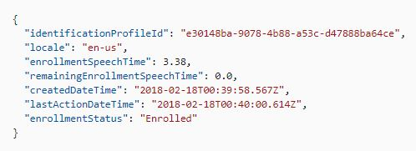
Return values
When the enrollment process is successful, the results returned from the Get Profile method are in a well-formatted JSON object or array that looks like this example.

Slide 48
Speaker recognition
The speaker-verification process consists of three major steps:
1.Create a verification profile.
2.Create three verification phrase enrollments.
3.Attempt to verify a speaker.

Slide 49
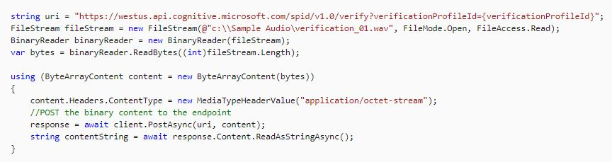
Binary file payload:
audio file:

Slide 50
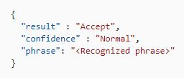
Return values
The information returned from a call to the Verify method provides all the information necessary to verify a speaker:
Result: A value of Accept or Reject
Confidence: A value of Low, Normal, or High
Phrase: The recognized verification phrase from the audio file

Slide 51
Speaker identification
Like speaker verification, the speaker-identification process consists of three major steps:
1.Create an identification profile.
2.Create an identification enrollment.
3.Attempt to identify a speaker.

Slide 52
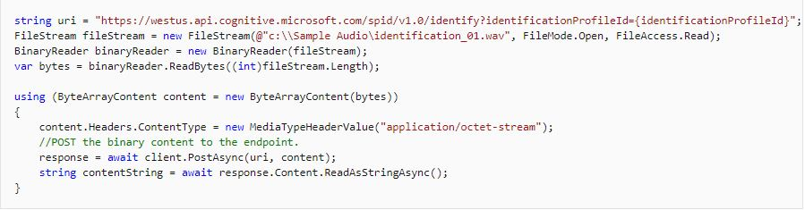
Binary file payload

Slide 53

Identification return values
The information returned from a call to the Identify method provides all the information necessary to identify a speaker:
identifiedProfileId: The identificationProfileId value of the identified speaker's profile
Confidence: A value of Low, Normal, or High

Slide 54
Summary
The Speaker Verification API can automatically verify and authenticate users by using their voice or speech. Each voice has unique characteristics that can be used to identify a person, just like a fingerprint. Using voice for access control not only offers better security, but also simplifies the authentication experience for customers.

